Slide 1
Modular Sculpture
Studio Sculpture
Mrs. Pountain

Slide 2
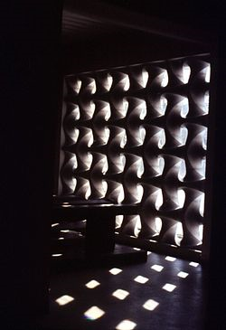
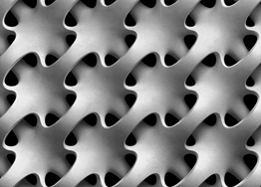
Modular constructivism
a style of sculpture that emerged in the 1950s and 1960s. It is based on carefully structured modules which allow for intricate and in some cases infinite patterns of repetition.
sometimes used to create limitless, basically planar, screen-like formations, and sometimes employed to make more multidimensional structures.

Slide 3
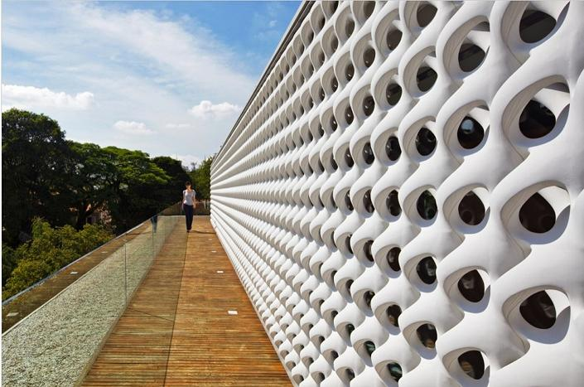
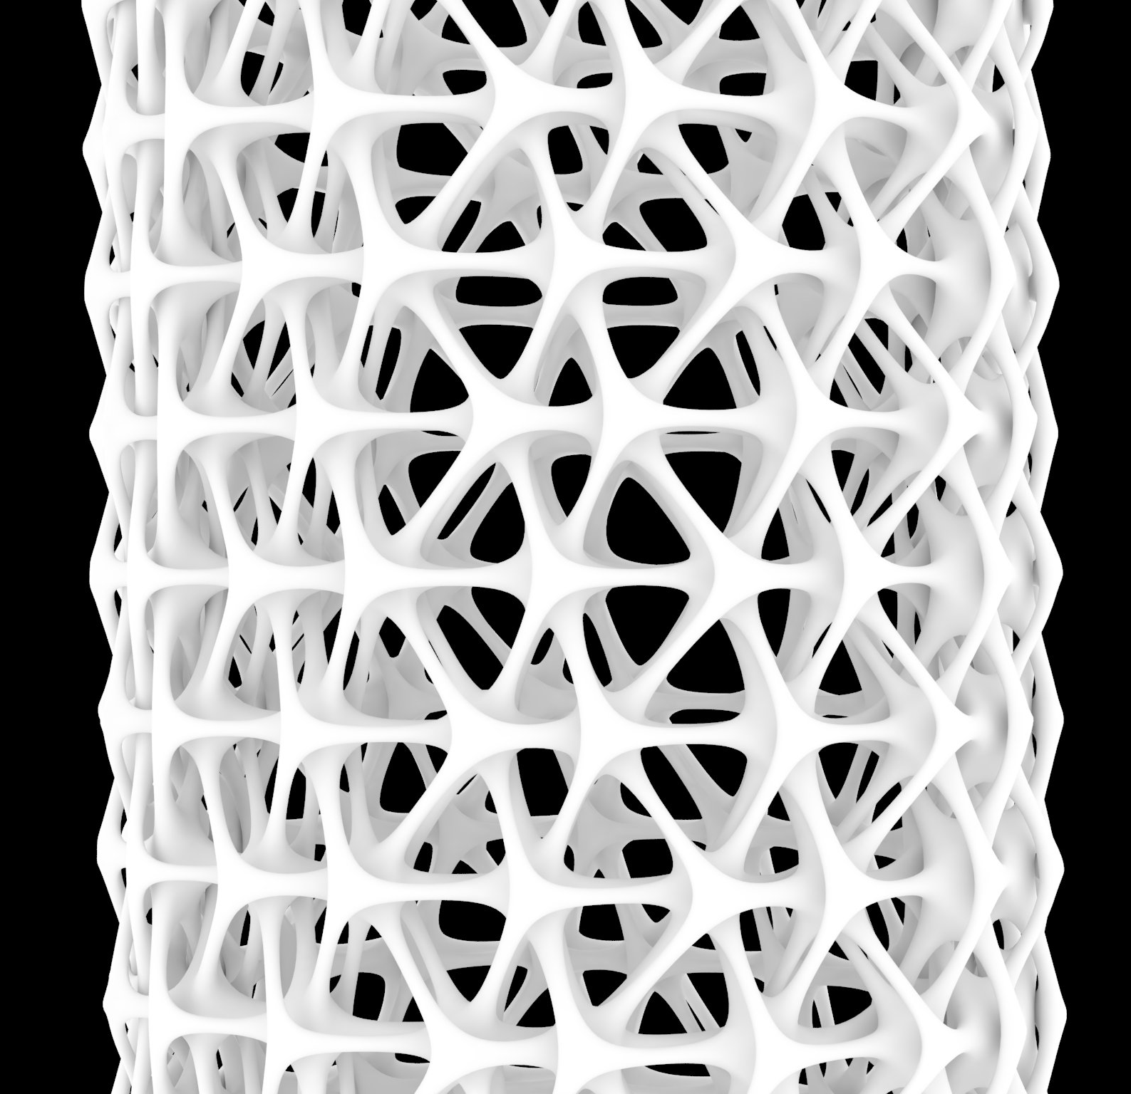
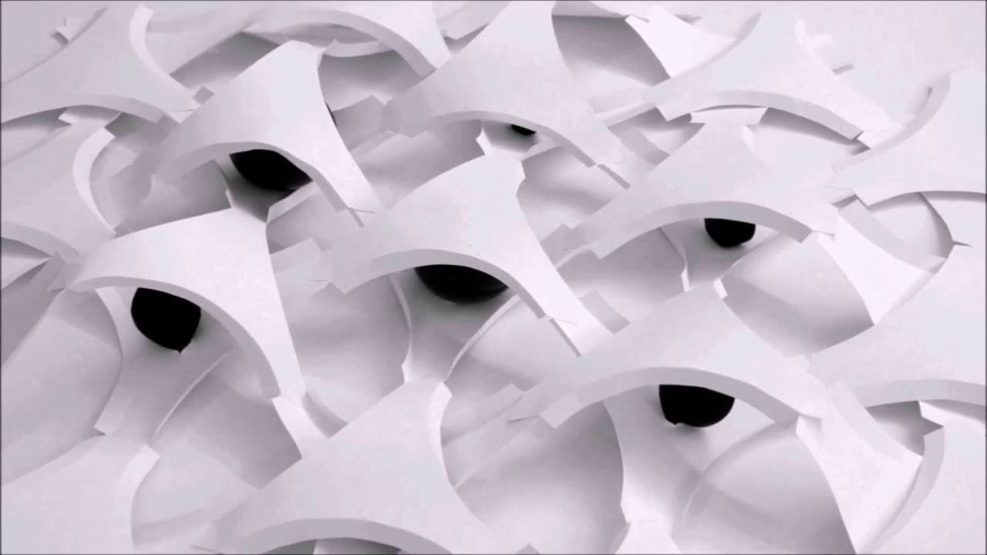
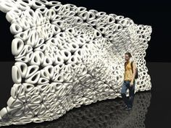
Erwin Hauer

Slide 4
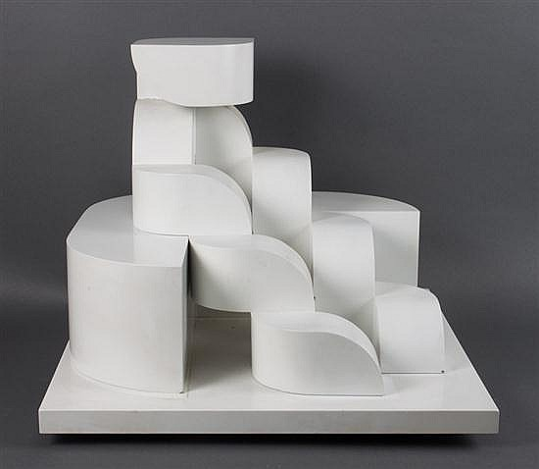
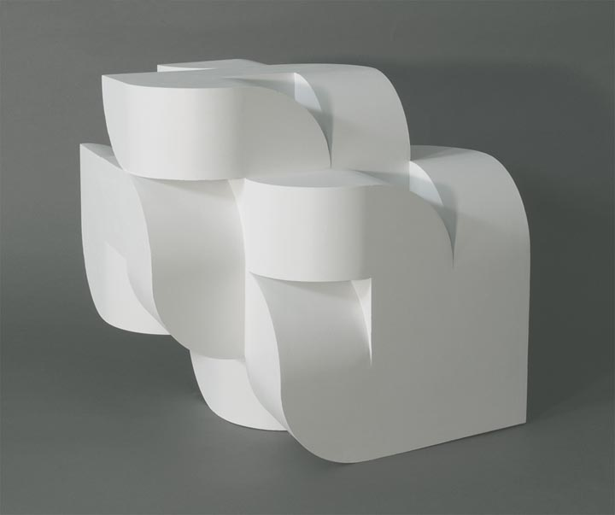
Norman Carlberg

Slide 5
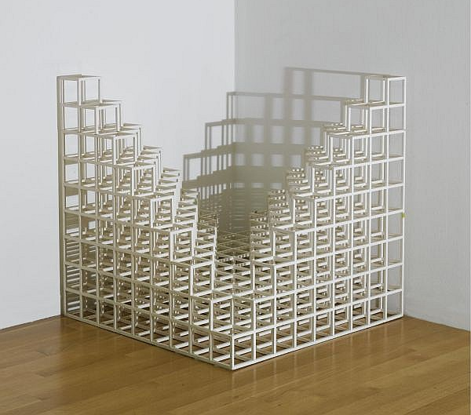
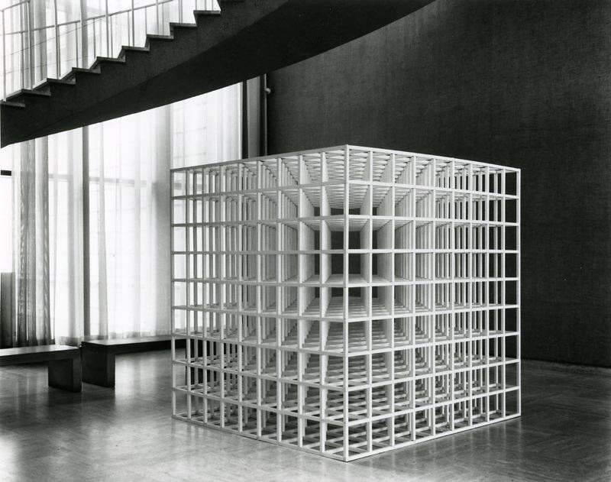
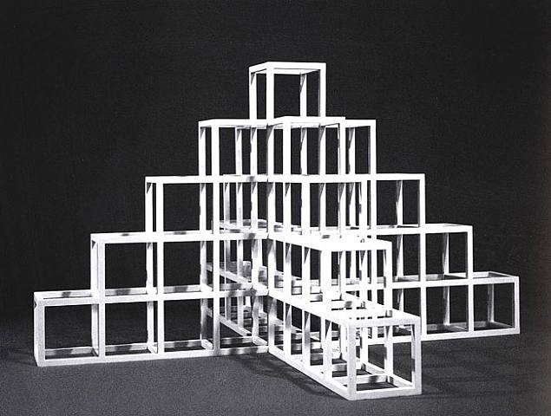
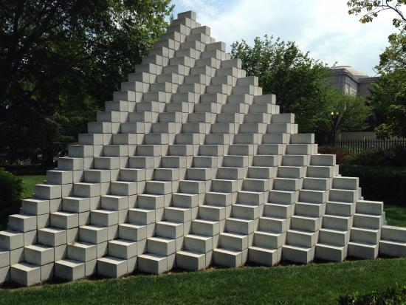
Sol LeWitt

Slide 6
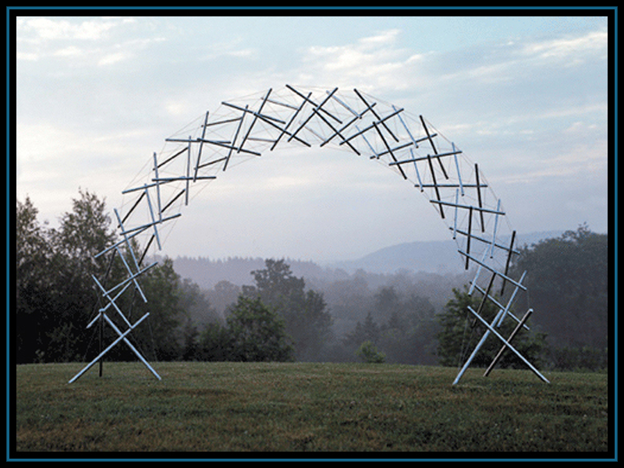
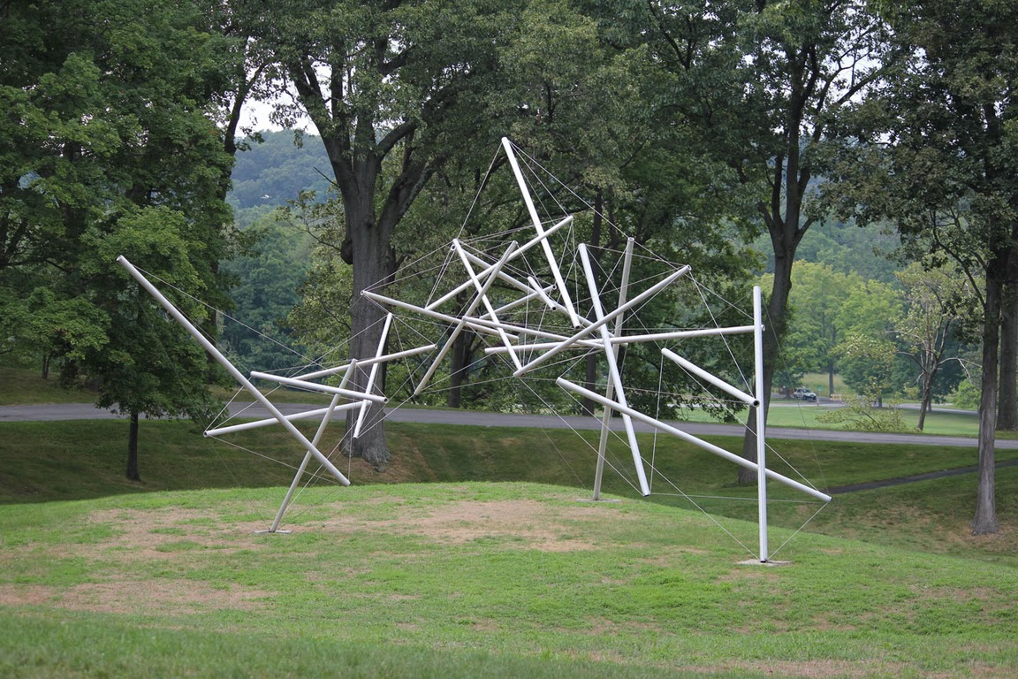
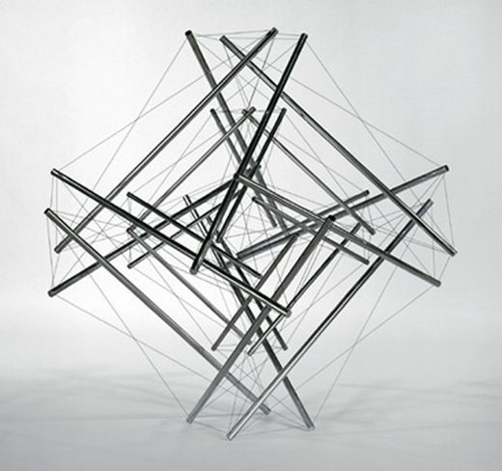
Kenneth Snelson

Slide 7
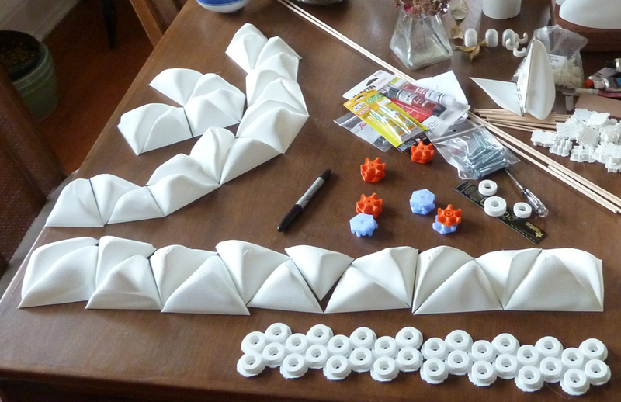
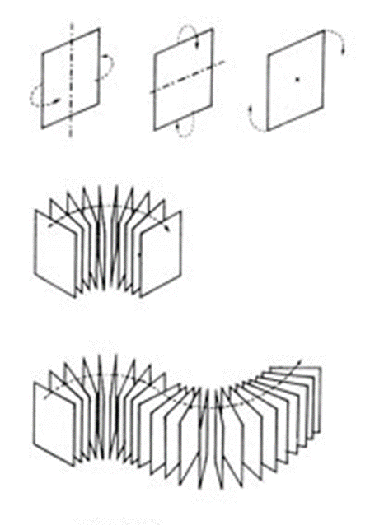
Module
Identical Segments to create form
Constructed with standardized units or dimensions

Slide 8
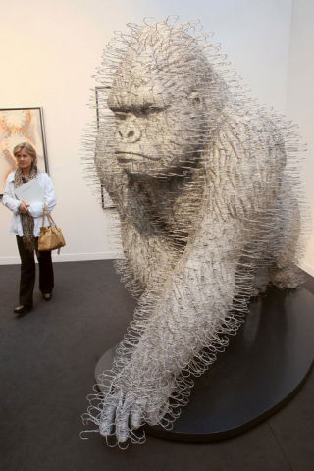
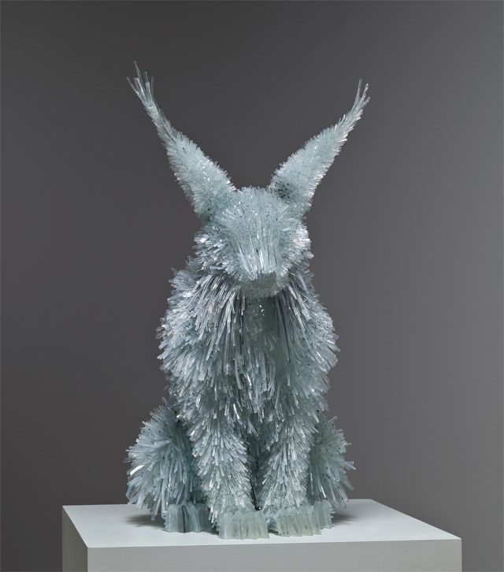
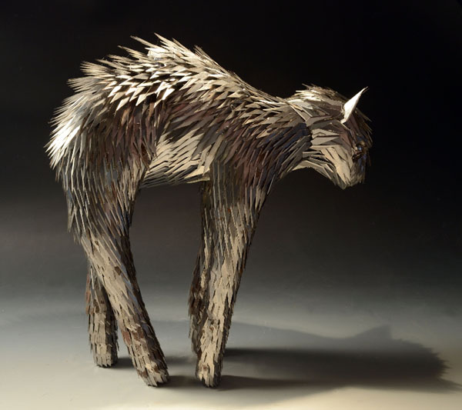
Module
Broken Glass
Coat Hangers
X-acto blades

Slide 9
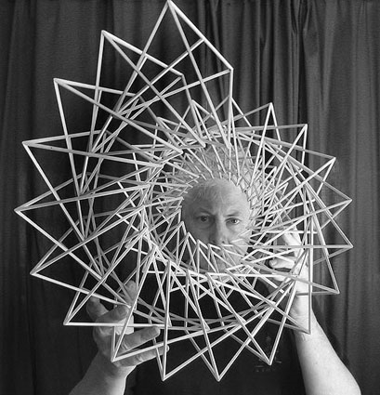
Vocabulary
Repetition
Negative Space
Movement
Line
Plane
Form

Slide 10
Assignment
Transform a 2-d Plane into a 3-d modular sculpture
Create your own modules (minimum of 20) from a 20in by 30in Piece of taskboard
Must show movement, repetition, negative space and line
Be as creative as you can with your solution (everyone is starting from the same place) Make several preliminary sketches in your sketchbook and a plan of attack for cutting/ building your modules before you begin
Note: This is an Additive Sculpture using the Construction method

Slide 11
Making Modules
You can make multiples of one single 2-d shape (plane) or glue pieces together to make dimensional modules (form)
All constructed modules will need time to dry before construction
Measure twice, cut once
Be thoughtful about how to best cutout your shapes (be efficient and maximize the space)
Cuts must be clean and even
Refer to the attached slides for particular properties of taskboard that are of interest and quite useful

Slide 12
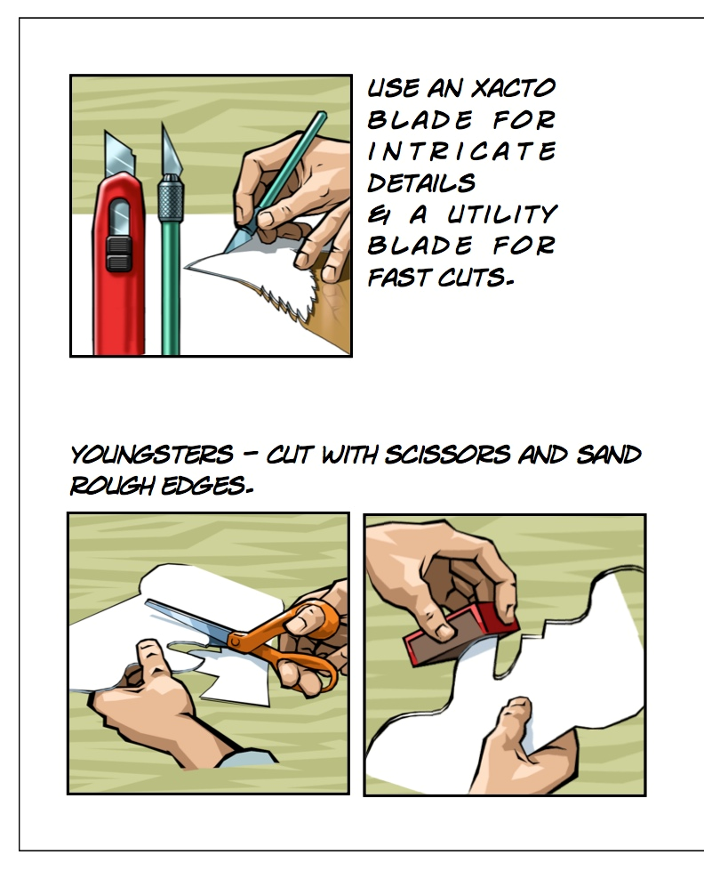
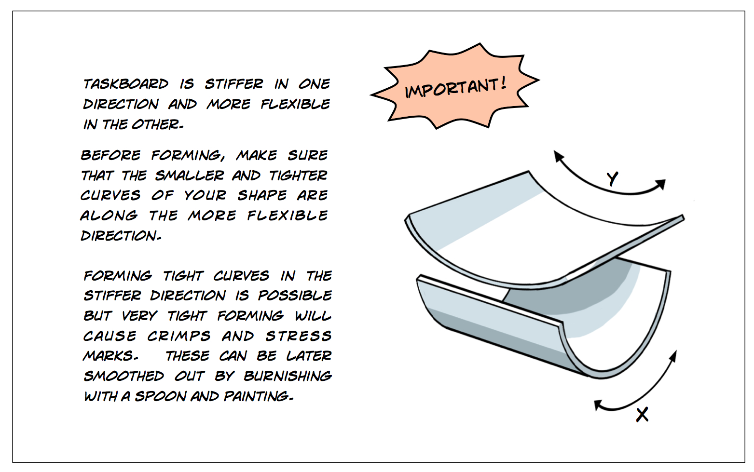

Slide 13
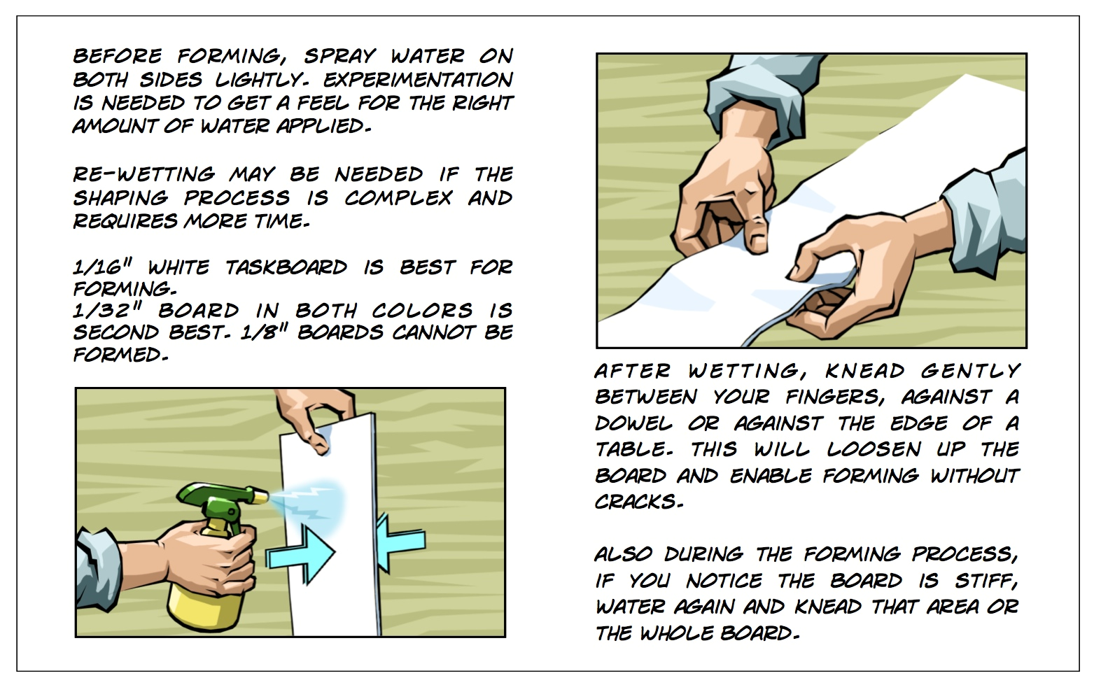

Slide 14
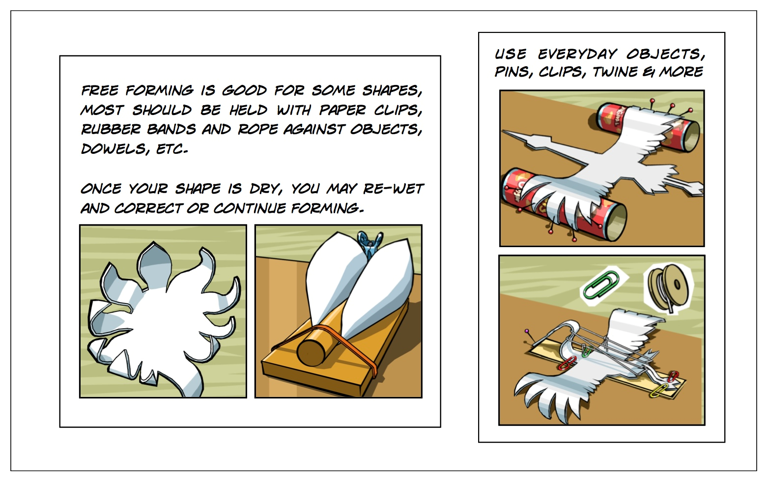

Slide 15
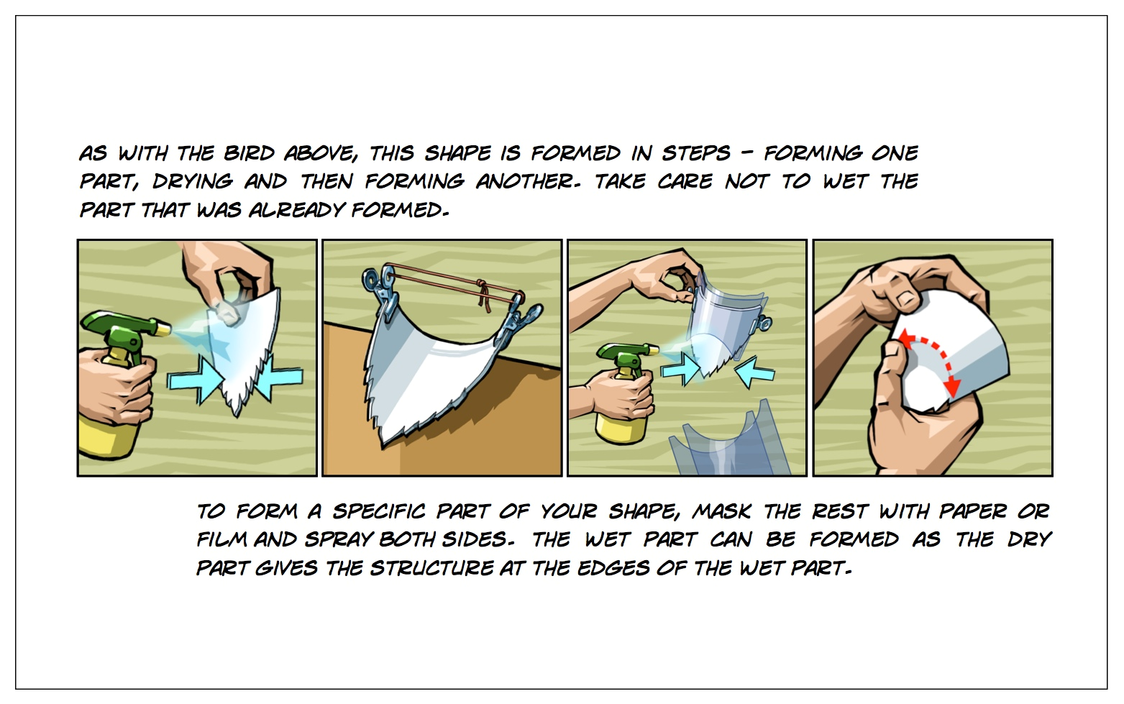

Slide 16
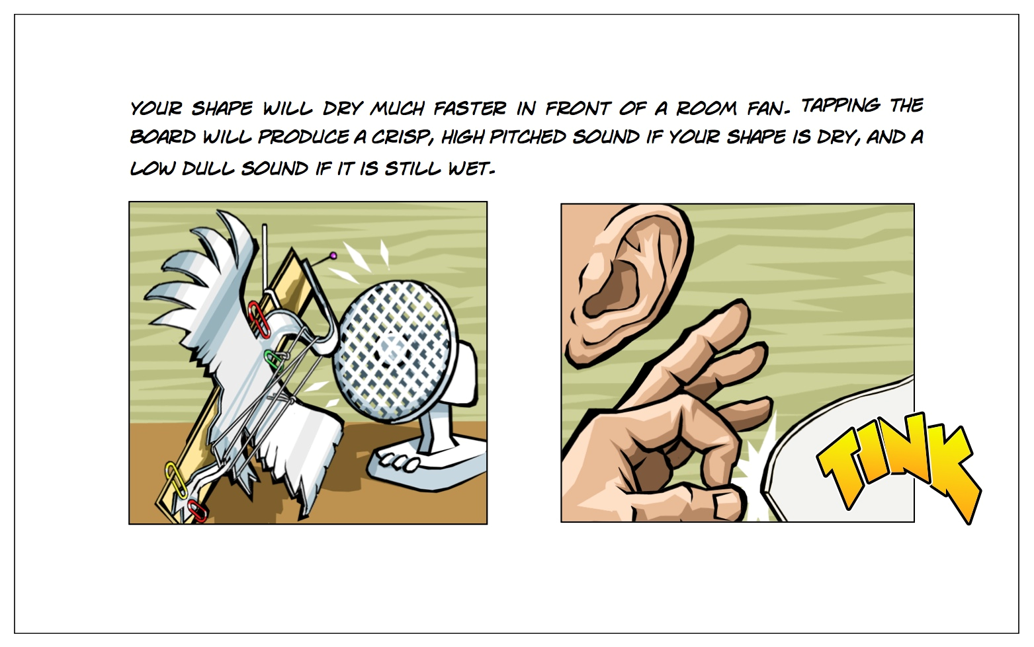

Slide 17
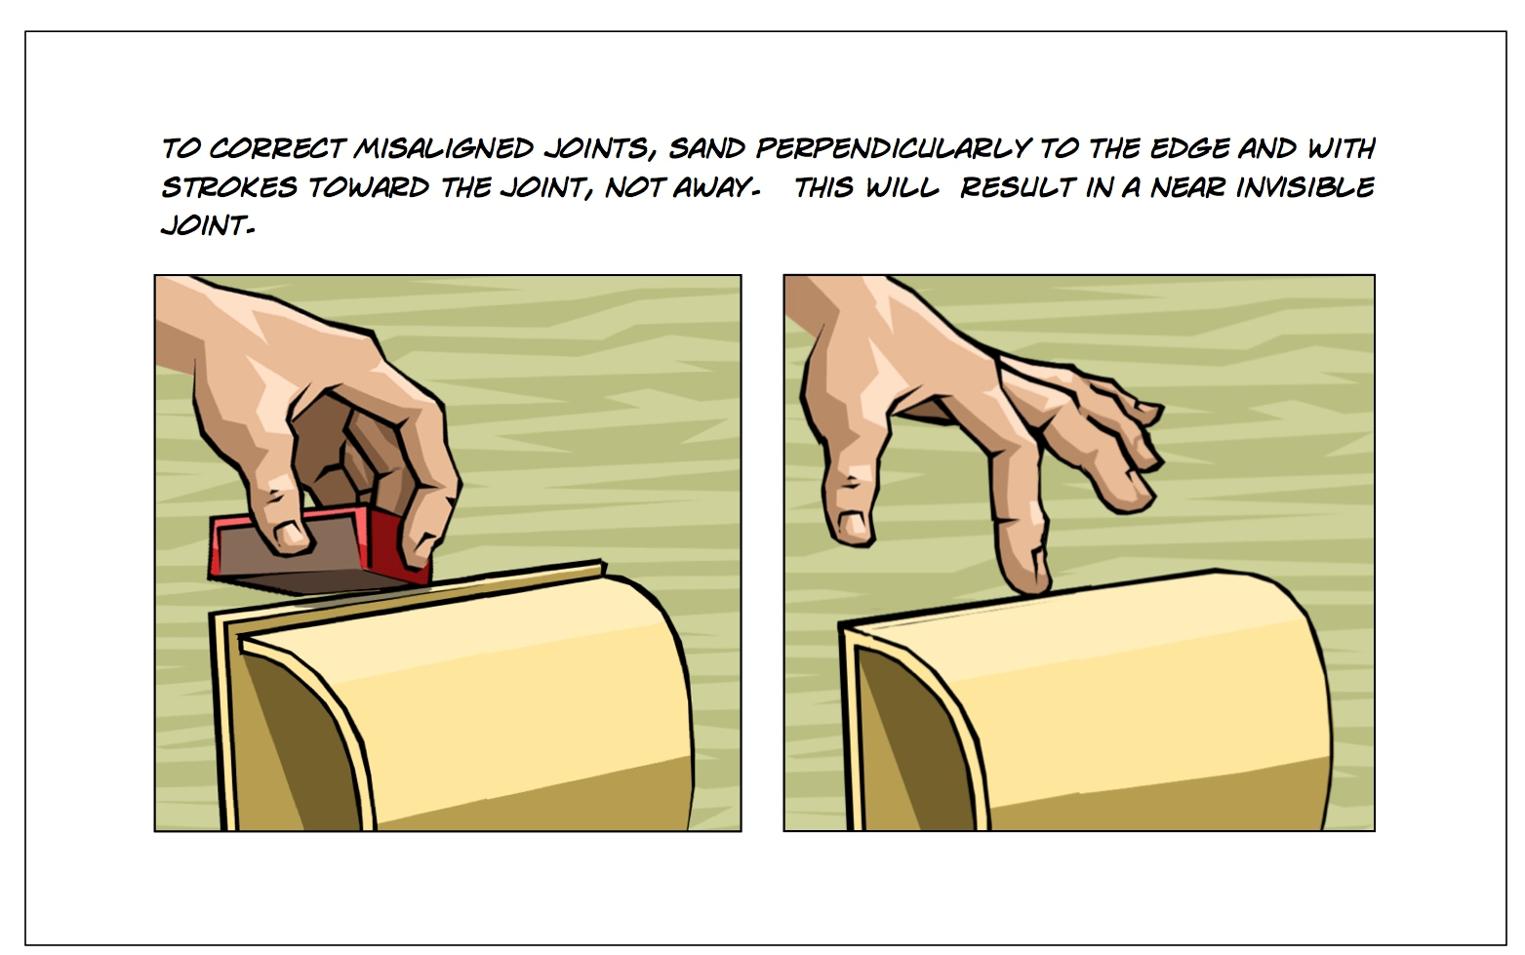

Slide 18
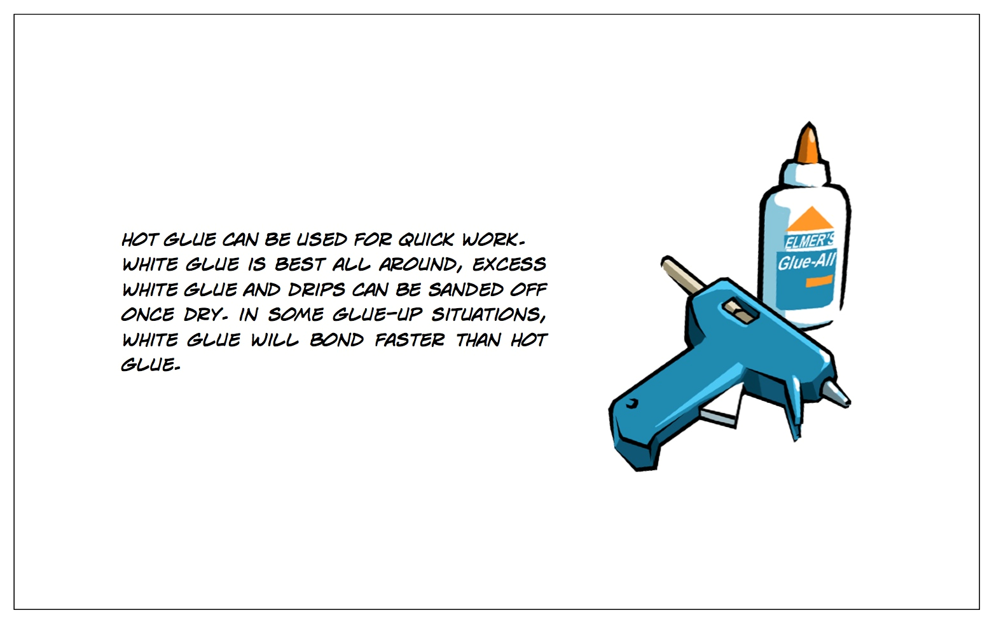

Slide 19
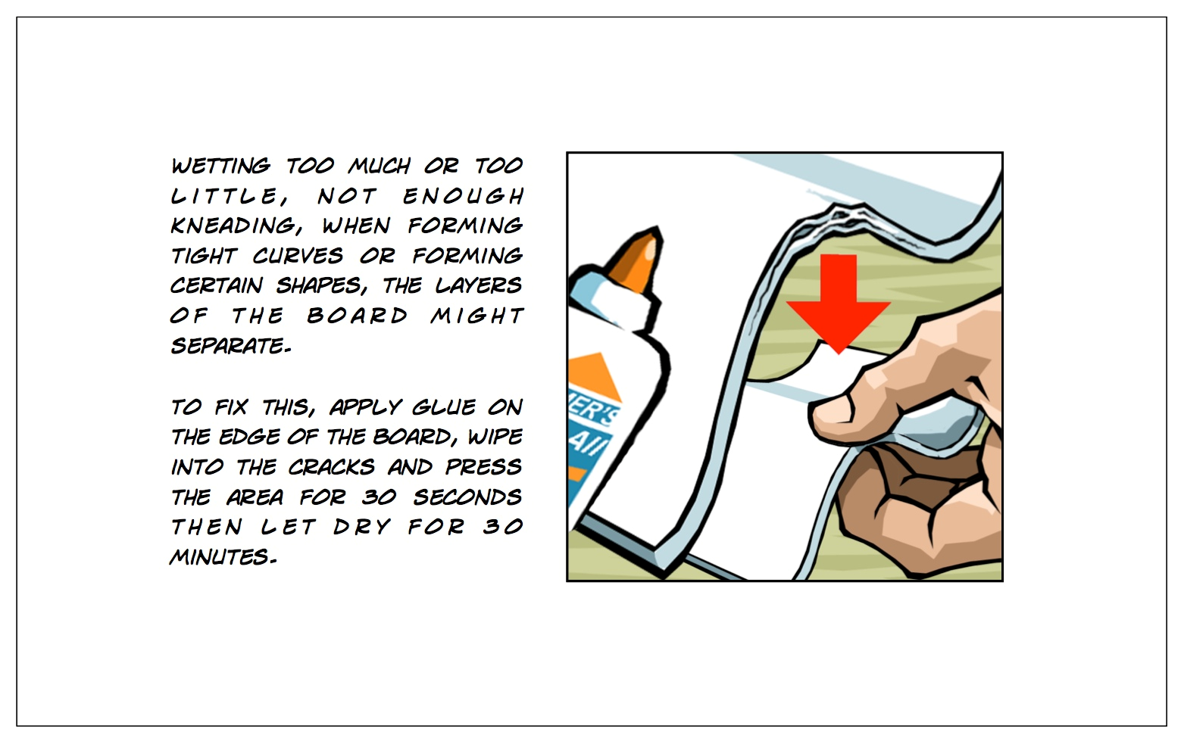

Slide 20
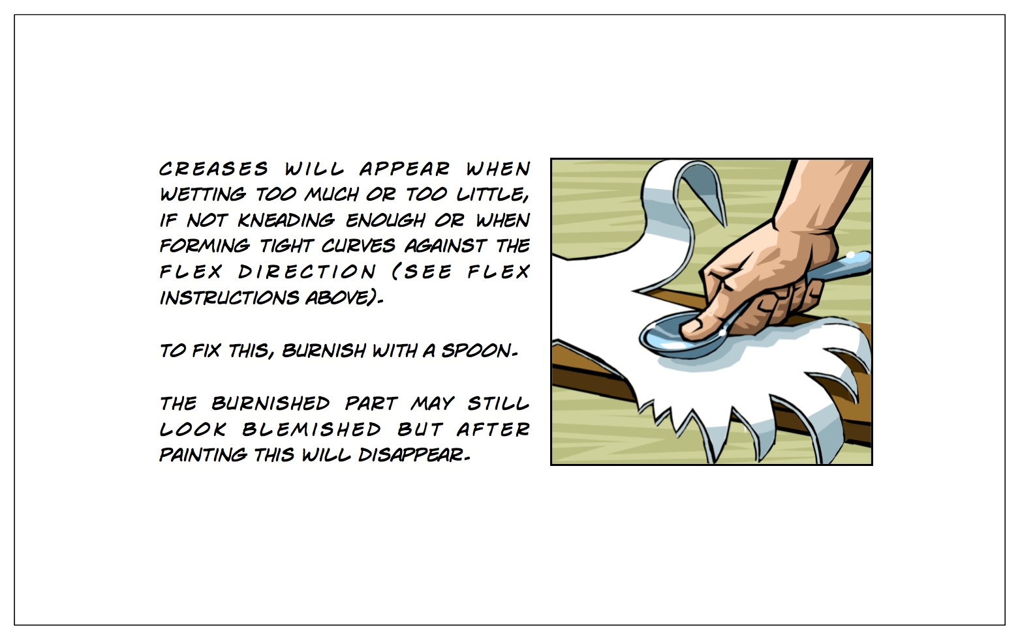

Slide 21
